Slide 1
(High School) Vector
李宏毅
Hung-yi Lee

Slide 2


Vectors
A vector v is a set of numbers
$$\left[\begin{matrix}1 \\ 2 \\ 3\end{matrix}\right]$$
v =
v =
$$\left[\begin{matrix}1 & 2 & 3\end{matrix}\right]$$
Row vector
Column vector
In this course, the term vector refers to a column vector unless being explicitly mentioned otherwise.
Notes:
一组数字用符号表示

Slide 3
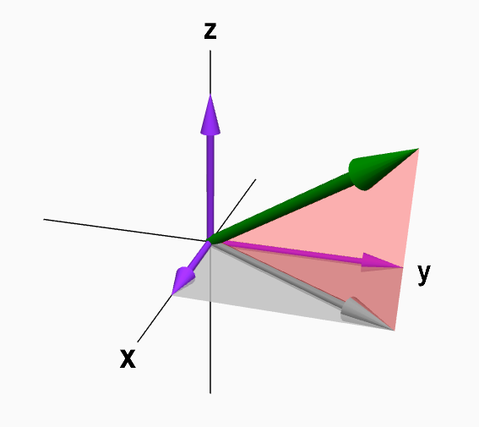
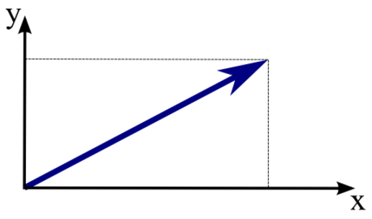

Vectors
$$\left[\begin{matrix}1 \\ 2 \\ 3\end{matrix}\right]$$
v =
components: the entries of a vector.
The i-th component of vector v refers to v_{i}
v₁=1, v₂=2, v₃=3
If a vector only has less than four components, you can visualize it.
v₃
v
v₂
v
v₂
v₁
v₁
http://mathinsight.org/vectors_cartesian_coordinates_2d_3d#vector3D

Slide 4

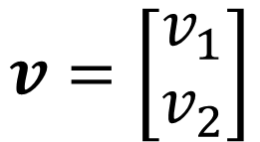






Scalar Multiplication
$$v=\left[\begin{matrix}v_{1} \\ v_{2}\end{matrix}\right]$$
$${2v}_{2}$$
$$2v$$
$$v_{2}$$
$$v$$
$$cv=\left[\begin{matrix}cv_{1} \\ cv_{2}\end{matrix}\right]$$
$$v_{1}$$
$${2v}_{1}$$
Notes:
scalar multiplication for a vector

Slide 5
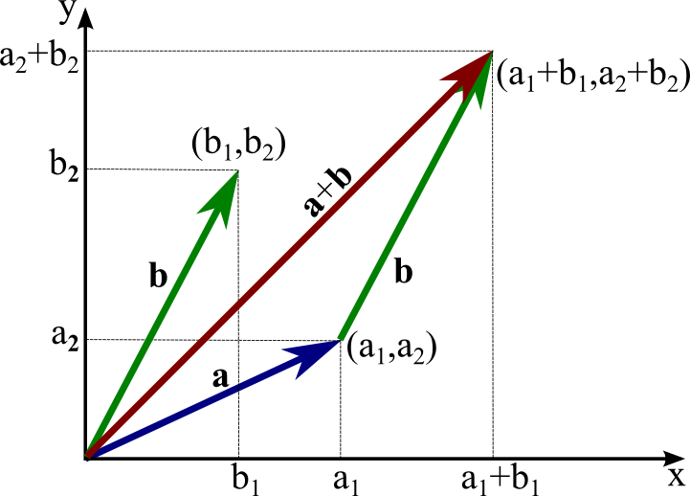
Vector Addition
http://mathinsight.org/vectors_cartesian_coordinates_2d_3d#vector3D
Notes:
加同一维的

Slide 6
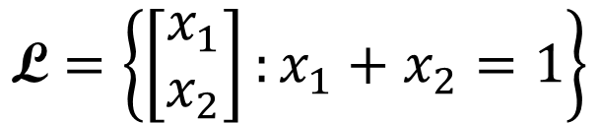

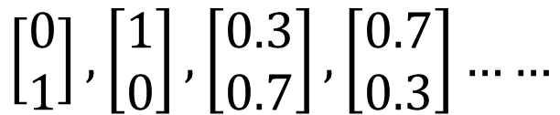
Vector Set
$$\left\{\left[\begin{matrix}1 \\ 2 \\ 3\end{matrix}\right],\left[\begin{matrix}4 \\ 5 \\ 6\end{matrix}\right],\left[\begin{matrix}6 \\ 8 \\ 9\end{matrix}\right],\left[\begin{matrix}9 \\ 0 \\ 2\end{matrix}\right]\right\}$$
A vector set with 4 elements
A vector set can contain infinite elements
$$\text{L}=\left\{\left[\begin{matrix}x_{1} \\ x_{2}\end{matrix}\right]:x_{1}+x_{2}=1\right\}$$
$$\left[\begin{matrix}0 \\ 1\end{matrix}\right],\left[\begin{matrix}1 \\ 0\end{matrix}\right],\left[\begin{matrix}0.3 \\ 0.7\end{matrix}\right],\left[\begin{matrix}0.7 \\ 0.3\end{matrix}\right]……$$
……
……

Slide 7
Vector Set
R^{n} :We denote the set of all vectors with n entries by R^{n} .

Slide 8

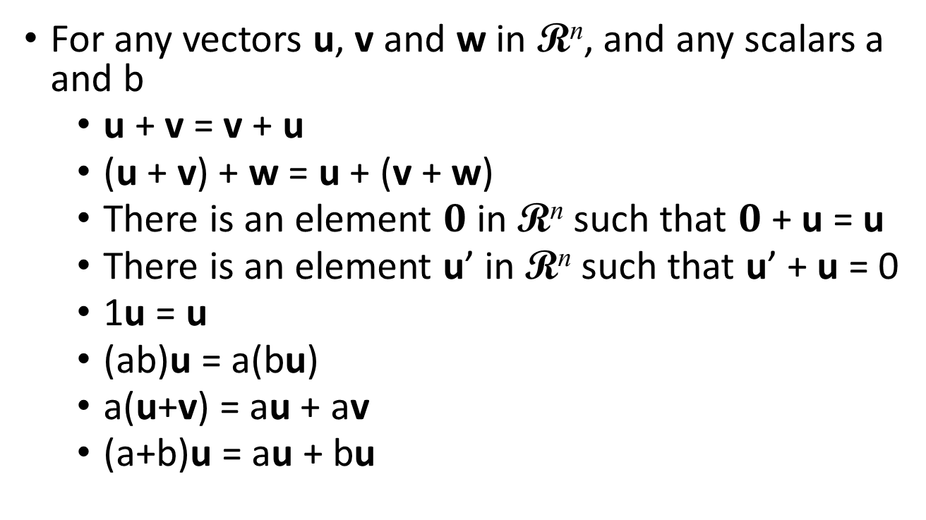
Properties of Vector
The objects have the following 8 properties are “vectors”.
For any vectors u, v and w in R^{n}, and any scalars a and b
u + v = v + u
(u + v) + w = u + (v + w)
There is an element $0$ in R^{n} such that $0$ + u = u
There is an element u’ in R^{n} such that u’ + u = 0
1u = u
(ab)u = a(bu)
a(u+v) = au + av
(a+b)u = au + bu
$$0=\left[\begin{matrix}0 \\ ⋮ \\ 0\end{matrix}\right]$$
zero vector
u’ is the additive inverse of u

Slide 9
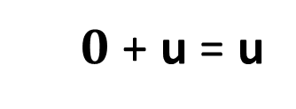
More Properties of Vector
$0$ + u = u
u’ + u = 0
For any vectors u, v and w in R^{n}, and any scalar a
If u + v = w + v, then u = w
If u + v = u + w, then v = w
The zero vector 0 is unique. It is the only vector in R^{n} that satisfies 0 + u = u
Each vector in R^{n} has exactly one u’
0u = 0
a0 = 0
u’ = -1(u) = -u
(-a)u = a(-u) = -(au)

